Slide 1
Dynamic scoring: attractions, challenges and trade-offs
Stuart Adam
Antoine Bozio
OECD, Paris, 4 June 2009

Slide 2
Outline
What is dynamic scoring?
The requirements for dynamic scoring
Should we use dynamic scoring? Options and trade-offs

Slide 3
What is dynamic scoring?
Government policies have many effects on individual behaviour and the economy as a whole
These economic effects have budgetary consequences
‘Dynamic scoring’ means including all these budgetary consequences in the costing of proposals
No doubt this would be desirable if consequences could be measured
No doubt either that a perfect measure is currently unattainable

Slide 4
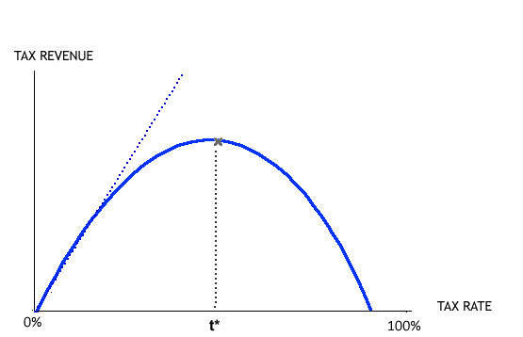
The Laffer curve

Slide 5
A more refined debate
The scope of dynamic scoring
Taxes, spending and other laws
‘Static’ versus ‘dynamic’ is misleading terminology
Current (US and UK) practice does allow for some economic effects
Wrongly suggests only two options
Wrongly suggests the only choice is which single number to prefer
What the numbers mean
Scoring is about measuring the budgetary impact of proposals
NOT measuring economic stimulus, welfare cost, etc

Slide 6
Requirements for full dynamic scoring
Defining the reform
The ‘mechanical’ effects of policies
First-round behavioural responses
General equilibrium and macroeconomic effects

Slide 7
Defining the reform
What would ‘no reform’ mean?
Part of reform is the implicit change in borrowing
Borrowing means future tax rises or spending cuts
These affect the economy when they happen
People also respond now to the expected future tax rises / spending cuts

Slide 8
The ‘mechanical’ effects of policies
Assumes behaviour unchanged
Often straightforward to calculate
e.g. the cost of reducing tax from 40% to 30% on an unchanged tax base is 25% of the baseline revenue.
Data sometimes unavailable
e.g. if widening the tax base, the new tax base might be unknown
Sometimes incoherent to assume no behavioural response
e.g. a tax cut must be spent or saved; spending and saving cannot BOTH be unchanged

Slide 9
First-round behavioural responses (1)
People respond to incentives created
Estimate how people respond by looking at reactions to past changes
But many different aspects of behaviour can respond
Income tax can influence decisions about hours of work, effort, occupation, retirement, education, amount and form of saving, business activities, use of fringe benefits, tax avoidance and evasion, migration,…
So many different things to estimate
The `New Tax Responsiveness’ literature simplifies this
Just measure the responsiveness of taxable income directly
But sometimes different channels have different implications
And multi-faceted responses are only one of the difficulties…

Slide 10
First-round behavioural responses (2)
Reforms rarely replicate old ones: tax and spending systems complex!
Heterogeneous population
Short-term versus long-term effects
Disputed estimates
Past estimates may not apply in different context

Slide 11
General equilibrium and macroeconomic effects
General equilibrium effects
Responses change supply, demand and prices, with further knock-on effects
Particularly difficult to estimate as the structure of the entire economy needs to be known
Aggregate demand effects
Tax cut or increased spending can lead to increased economic activity
Multiplier effect: boost in demand generates income that is spent and fuels further demand
Crowding-out effect: effects of fiscal stimulus can be limited if it only replaces private activity
Depends on whether the economy is operating at or below full capacity

Slide 12
Expectations and institutional responses
Reforms change expectations
Of future taxes and spending, inflation, interest rates, etc
This has a big effect on how people respond to the reform
Expectations very difficult to model; results sensitive to assumptions
How are other policy-makers assumed to react?
Monetary policy
Other countries, other levels of government

Slide 13
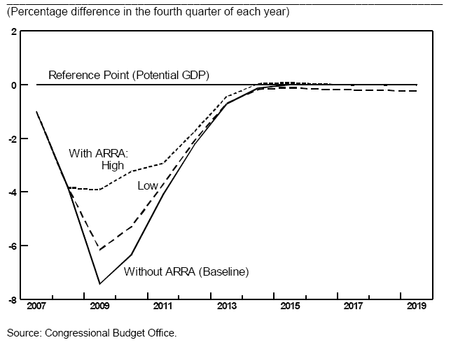
Choosing assumptions and models Effect of ARRA 2009 on US output gap

Slide 14
Should dynamic scoring be used?
Reliably accurate dynamic scoring is out of reach
But this does not imply it should not be attempted
More interesting questions are often harder to answer!
Goal is to provide clear and credible information about policy choices within time and cost constraints

Slide 15
Clarifying the question (1)
Scoring versus forecasting
Forecasting the budgetary position is not the same as estimating the effect of reforms on the budgetary position
UK forecasting is ‘dynamic’ (in principle) while scoring is not
In this case the issue is whether to attribute revision of forecasts to reforms
Scoring whole packages (e.g. Budgets) versus individual measures

Slide 16
Clarifying the question (2)
Not just two options
Many possibilities between purely mechanical and fully dynamic scoring
Exactly what effects incorporated, and what assumed unchanged?
Not just one number
How deal with uncertainty?
Dynamic scoring versus dynamic analysis
The institutional set-up
Who performs the analysis?
Who commissions the analysis?
What is made public and what is confidential?

Slide 17
Credibility
Accuracy
Ignoring important effects is a problem here
But so is spurious precision
A role for acknowledging uncertainty?
Neutrality
Dynamic scoring often called for where there is no political consensus
Actual and perceived neutrality are both important
Become harder to achieve when more judgement and guesswork involved
Transparency
What definitions, assumptions, methodologies, estimates and models lie behind conclusions
Can promote trust even if process flawed

Slide 18
Clarity
Too many numbers can confuse instead of enlightening
Difficult to discern general principles
Depends on nature of debate and what people thought able to absorb
Consistent methodology helps to make proposals comparable
Avoids bias
Suggests a simple approach
But might want fuller analysis of major proposals?

Slide 19
Practical considerations
Dynamic scoring is costly
Would require major increase in resources dedicated to scoring
Do benefits outweigh these costs?
More worthwhile than alternative uses of funds?
Dynamic scoring is slow
Policy-makers want analysis quickly
So do those responding: perceptions form quickly and media moves on!

Slide 20
Conclusions
Reliably accurate dynamic scoring is out of reach
The requirements are truly formidable
Big advances have been made, but we must acknowledge the scale of our ignorance
This is not sufficient reason for declining to attempt it
A ‘best guess’ might be preferable to ignoring important effects
But the difficulty of dynamic scoring implies other downsides
Costly and slow
Hard to achieve consistency across proposals
Hard to keep impartial and trusted
Do the evident advantages outweigh these disadvantages?
Adopting a single dynamic cost estimate for each measure isn’t the only option
What exactly is held constant and what allowed to change?
Whole package versus individual measures?
Dynamic analysis of possible economic effects without a dynamic bottom line?
Transparency is crucial
First step to improving the quality of analysis is to open it up to scrutiny

Slide 21
Dynamic scoring: attractions, challenges and trade-offs
Stuart Adam
Antoine Bozio
OECD, Paris, 4 June 2009

