Slide 1
Do Consumers Gamble to Convexify?
September 2010
Thomas Crossley (Cambridge and IFS)
Hamish Low (Cambridge and IFS)
Sarah Smith (Bristol and IFS)

Slide 2
The basic idea
“On Friday September 4th 1994, the freezer belonging to Gloria and Steve Kanoy of Weere’s Cove suddenly and mysteriously broke down…... Stopping for gas at Lake Raceway, 607 Main Avenue, they decided to buy a Lotto ticket…”
Virginia Lottery winner awareness campaign
quoted in Clotfelter and Cook (1990)

Slide 3
Basic idea and preview
Why do people take part in lotteries?
One answer: if liquidity constrained, discrete decisions generate local value function non-concavities....gamble to finance indivisible spending
Proposed by Ng (1965) – but limited empirical evidence
This paper:
Compare durable spending responses to lottery winnings to responses to other windfalls (inheritances)
Compared for two groups – those who are likely liquidity constrained and those who are not
Evidence consistent with a model in which liquidity constrained consumers use lotteries to finance lumpy spending

Slide 4
Why does this matter?
For economic theory:
Empirical support for a theoretical model that can explain why risk-averse people would rationally choose to gamble
Support for a technical fix used in dynamic models (Rogerson, 1988; Lentz and Traneas, 2004)

Slide 5
Why does this matter (2)?
For economic policy:
Can we use lotteries to estimate income effects (e.g. Imbens et al, 2001)?
An external validity problem analogous to randomization bias in randomized trials - but with strong economic intuition
More generally: insights into the finances of low-income households

Slide 6
Related literature
Theory: Ng (1965), Bailey et al (1980), Hartley and Farrell (2002)
Evidence:
Besley et al (1993) –Rotating Savings and Credit Associations (ROSCAs),
Groups of people make regular contributions to a fund,
the total amounts allocated to one member in each cycle via a lottery,
Frequently used to “save up” for purchase of indivisible goods.
Yuchtman (2005) – Experiment.
People more prepared to gamble when the winnings are allocated to an indivisible good

Slide 7
Timing:
A model of gambling and indivisible purchase
One period model (no borrowing/ saving)
Beginning of period
End of period
Stage 1
Whether
to buy a
lottery ticket
Winnings
Stage 2
Decision
Over
Spending

Slide 8
First Stage
,
Agent with cash on hand x₁ buys at most one actuarially fair lottery ticket at price 1:
Action and Outcome | Probability | Net winnings | Cash on Hand
Don’t Play |  | 0
Play, Win
Play, Lose

Slide 9
Second Stage
Buy at most one unit of an indivisible good at price p :

Slide 10
Figure 1: Indivisible Purchase Decision
d = 0
d = 1

Slide 11
Analysis
A lottery ticket is purchased iff:

Slide 12
Figure: Lottery Decision, Bounds

Slide 13
Analysis (2)

Slide 14
Figure 2: Lottery and Indivisible Purchase Decisions

Slide 15
Implications for Estimating Income Effects
Let F(·) be the cumulative distribution of cash-on-hand (x₁) (not observed)
Thought experiment 1: lottery by choice, as in model
Let λ be the fraction of lottery players in the model
Thought experiment 2: random compulsory lottery; fraction λ of population
We observe lottery winners and non-winners (those that don’t play, and those that lose.)
Others (notably Imbens et al., 2001) observe those that lose.

Slide 16
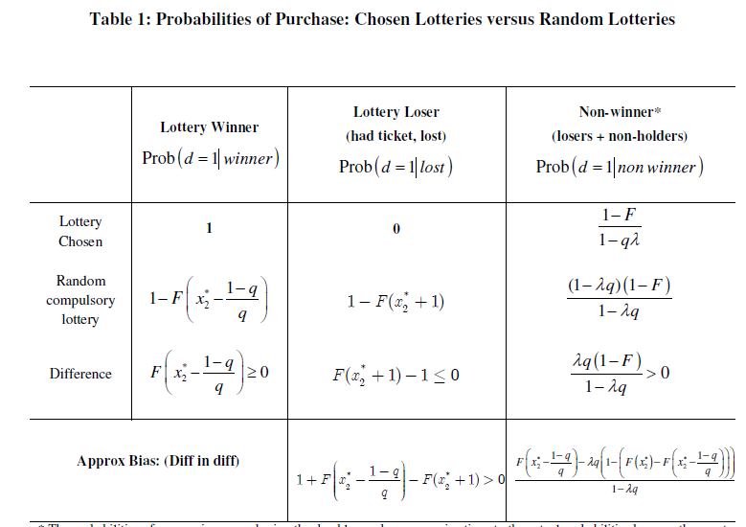

Slide 17
Figure 3: Chosen Lottery versus Random Lottery
Difference in probability of purchase
0.01
(high η)
0.008
0.006
(low η)
0.004
0.002
0.1
0.2
0.3
0.4
0.5
q: probability of lottery win

Slide 18
Incentives to gamble
Are diminished if
There is uninsurable income risk
There are many durables
Households can borrow and save
An empirical question
We look for evidence of the effects highlighted by the model in the BHPS

Slide 19
The data
British Household Panel Survey collected since 1991
We use data from waves 7 – 16
Select individuals in single/ couple households aged 20-70
6,430 households; 36,204 obs

Slide 20
Durables
Would you look at this card and tell me if you have any of the items listed in your (part of the) accommodation?
Colour TV
Freezer or fridge-freezer
Washing machine
Tumble-drier
Dishwasher
Home computer
For each item: was this (colour television) bought since September 1st last year?
Since 1997: How much in total have you paid for this (Colour television), excluding any interest paid on loans?

Slide 21
Are durables lumpy?
Second-hand?
Renting is possible, but more so for some durables (TVs) than others (fridges). Most companies have a minimum rental period of 12 or 18 months and require a credit check
Similarly, hire purchase companies also require a credit check and may charge high APRs (30% over 30 months)
Rental outlets targeted at those with no formal credit. Eg Crazy Jacks requires no formal credit checks, only five references. Advertised APR is 30%, but additional insurance typically increases the effective APR to >100% (Collard and Kempson (2005))

Slide 22
Liquidity constraints
In our sample, someone is liquidity constrained if there is no interest or dividend income accruing to the household (42% of the sample)
Additional criteria
Not a home-owner (17% of the sample) OR
Bottom half of the household income distribution (26% of the sample)
Young and Waldron (2008) 16% of the UK population is liquidity constrained (either perceived or actual).
Jappelli (1990) c. 20% of US households are credit constrained based on survey evidence that they have been refused credit, or put off applying for fear of refusal

Slide 23
Windfalls
Since 1997 the BHPS has included the following module about windfalls
Since September [last year] have you received any payments, or payment in kind, from anything listed on this card?
Life insurance policy
Lump sum pension
Personal accident claim
Redundancy payment
Inheritance/ bequest
Win on football pools, national lottery or another form of gambling
Anything else
About how much did you receive?
Exclude any inheritances linked to widow(er)hood

Slide 24
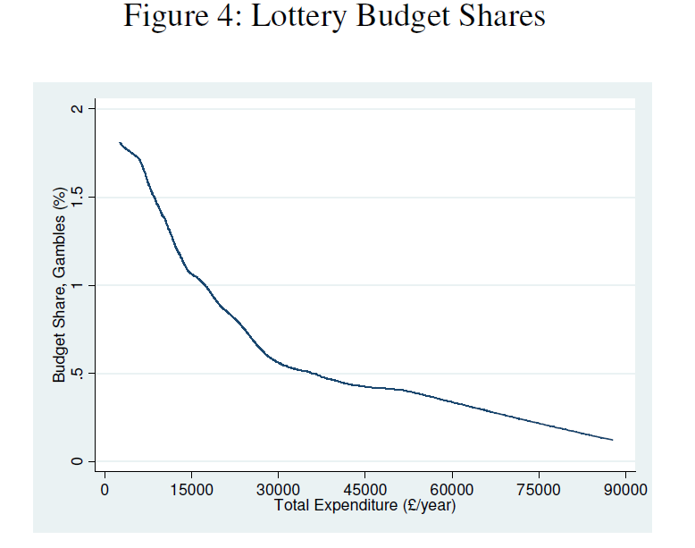

Slide 25
Distribution of windfalls
Distribution of windfalls from the Lottery is very different to that of inheritances
Landsberger (1966) and Keeler, James and Abdel-Ghany (1983) show that size of windfall affects what people do with it: The smaller the windfall, the more likely people are to spend it
Our approach is to focus on mid-range lottery wins/ inheritances of between £100 - £5,000
Throw away big winners (>£5,000)

Slide 26
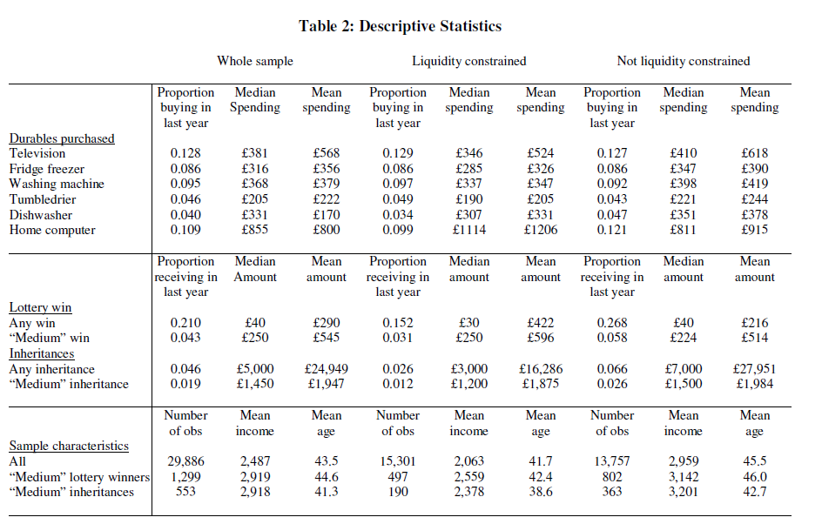

Slide 27
Empirical specification
Where
d_{it} = probability of durable purchase
Lot_{it} = lottery winnings
Inh_{it} = other windfall income (inheritance)
Q_{it} =credit constrained
X_{it} = other characteristics
“Triple Difference.”
Key prediction from the model: β ₂≠γ₂

Slide 28
Anticipation and “Emotional Accounting”
Differences-in-differences approach deals with the fact that other windfalls (inheritances) may be different in other ways
Anticipation effects
Emotional accounting
“Although all dollars are created equal, one may feel a pang of reluctance at spending grandma’s inheritance on a new sports car, but little reluctance spending casino earnings doing the same.” Epley and Gneezy (2007)

Slide 29
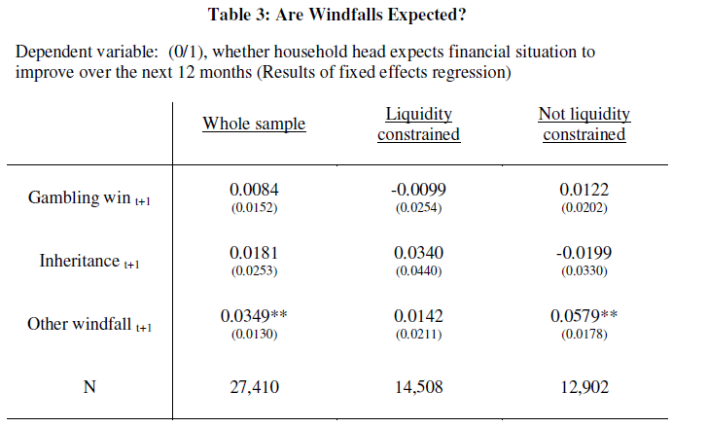

Slide 30
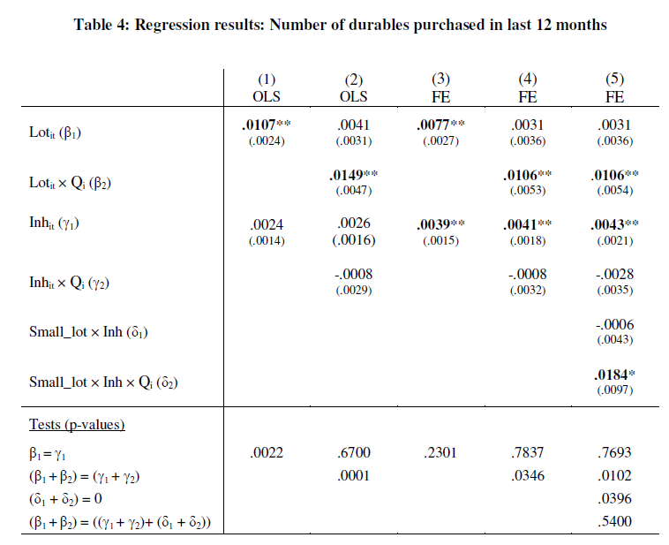

Slide 31
Alternative specifications
Findings are robust to:
Binary dependent variable
Alternative (narrower) measures of liquidity constraints
Inclusion of lead/ lag terms

Slide 32
Further test
Small lottery winnings (<£100) are not enough to finance durable spending, but are informative about whether someone plays the lottery (i.e. is in the region of the non-concavity)
Someone who has small lottery winnings and inherits a medium-sized amount and is liquidity constrained should behave in the same way as someone who has medium-sized lottery winnings and is liquidity constrained.
Where SmLot_{it} = small lottery winner (0,1)
See column 5

Slide 34
Conclusions
Evidence consistent with a model in which individuals play lotteries to finance lumpy items of spending.
Purchases of durables are more responsive to lottery wins than to other windfalls (inheritances)
This is only the case for consumers who are liquidity constrained
Also find a larger response among people who play the lottery (win small amounts) and inherit money

