Slide 1
Dynamic scoring: attractions, challenges and trade-offs
Stuart Adam
Antoine Bozio
HMRC/ESRC International Conference on Institutional Taxation Analysis
London, 21 September 2009

Slide 2
Outline
What is dynamic scoring?
Requirements and challenges for dynamic scoring
Should we use dynamic scoring? Options and trade-offs

Slide 3
What is dynamic scoring?
Government policies have many effects on individual behaviour and the economy as a whole
These economic effects have budgetary consequences
‘Dynamic scoring’ means including all these budgetary consequences in the costing of proposals
Applies to taxes, spending and other laws
Focus today mainly on official scoring of government policies
No doubt that desirable if could be done perfectly and easily
No doubt either that perfect measure currently unattainable

Slide 4
Challenges for full dynamic scoring
Defining the reform
Includes an implicit change in borrowing
The ‘mechanical’ effects of policies
Data sometimes unavailable
First-round behavioural responses
Huge number of response parameters to estimate
Many aspects of behaviour, policy parameters, types of people; short- vs long-run;...
Some well established; some disputed; many never estimated
Applicability of past estimates to different times and places
General equilibrium and macroeconomic effects
General equilibrium requires specifying structure of entire economy
Demand effects (crowding out, multipliers) depend on state of economy
Expectations are crucial, but difficult to model
How are other policy-makers assumed to react?

Slide 5
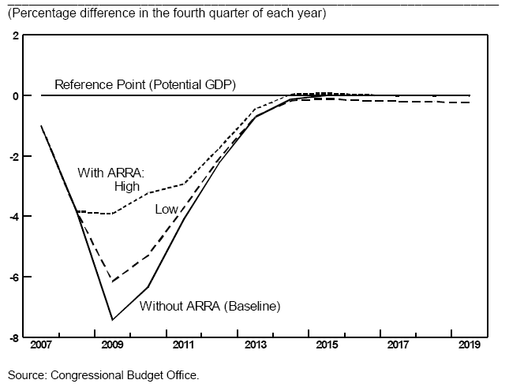
Choosing assumptions and models Effect of ARRA 2009 on US output gap

Slide 6
Should dynamic scoring be used?
Reliably accurate dynamic scoring is out of reach
But this does not imply it should not be attempted
More interesting questions are often harder to answer!
Goal is to provide clear and credible information about policy choices within time and cost constraints

Slide 7
Clarifying the question
Scoring versus forecasting
Forecasting the budgetary position is not the same as estimating the effect of reforms on the budgetary position
UK forecasting is ‘dynamic’ (in principle) while scoring is not
In this case the issue is whether to attribute revision of forecasts to reforms
Scoring whole packages (e.g. Budgets) versus individual measures
What effects should be incorporated?
Not just two options: ‘static’ vs ‘dynamic’ is misleading terminology
Exactly what effects incorporated, and what assumed unchanged?
What results should be presented?
Not necessarily just one number: how deal with uncertainty?
Dynamic scoring versus dynamic analysis

Slide 8
Credibility
Accuracy
Ignoring important effects is a problem here
But so is spurious precision
A role for acknowledging uncertainty?
Neutrality
Dynamic scoring often called for where there is no political consensus
Actual and perceived neutrality are both important
Become harder to achieve when more judgement and guesswork involved
Transparency
What definitions, assumptions, methodologies, estimates and models lie behind conclusions
Can promote trust even if process flawed

Slide 9
Clarity
Too many numbers can confuse instead of enlightening
Difficult to discern general principles
Depends on nature of debate and what people thought able to absorb
Consistent methodology helps to make proposals comparable
Avoids bias
Suggests a simple approach
But might want fuller analysis where more known, or of major proposals?

Slide 10
Practical considerations
Dynamic scoring is costly
Would require major increase in resources dedicated to scoring
Do benefits outweigh these costs?
More worthwhile than alternative uses of funds?
Dynamic scoring is slow
Policy-makers want analysis quickly
So do those responding: perceptions form quickly and media moves on!

Slide 11
Conclusions
Reliably accurate dynamic scoring is out of reach
Big advances have been made, but we must acknowledge the scale of our ignorance
But might a ‘best guess’ be preferable to simply ignoring important effects?
Dynamic scoring offers a big prize which should not be discarded lightly
More accurate picture of the budgetary consequences of policies
Fairer reflection of the advantages of policies that enhance economic performance
But the difficulty of dynamic scoring implies significant downsides
Costly and slow
Hard to achieve consistency across proposals
Hard to keep impartial and trusted
Do the potential advantages outweigh these disadvantages?
Adopting a single dynamic cost estimate for each measure isn’t the only option
What exactly is held constant and what allowed to change?
Whole package versus individual measures?
Dynamic analysis of possible economic effects without a dynamic bottom line?
Transparency is crucial
First step to improving the quality of analysis is to open it up to scrutiny

Slide 12
Dynamic scoring: attractions, challenges and trade-offs
Stuart Adam
Antoine Bozio
HMRC/ESRC International Conference on Institutional Taxation Analysis
London, 21 September 2009

