Slide 1
Cycles of poverty, unemployment and low pay
Chris Goulden
Joseph Rowntree Foundation

Slide 2
Benefits of a dynamic perspective
“Work is the best route out of poverty”
Yes - but only because other options are so bad
And ‘best’ does not mean ‘effective’
Poverty rates for couple families:
Without any work = 64%
Both working full-time = 1%
BUT – 70% of households in persistent poverty remain poor when someone in the family gets a new job

Slide 3
Child poverty and work
CHILD POVERTY RATES
SHARES OF CHILD POVERTY

Slide 4
Job insecurity and low pay
6% of all employees are temporarily employed
1 in 3 temporary jobs are low paid (vs. 1 in 5 overall)
Extent of low pay among temp workers varies
Two-thirds of seasonal workers
Half of casual workers
Two-fifths of agency temps
Low-paid temps more likely to want a permanent job
And more likely to be part-time and want full-time
Temporary posts are associated with less training

Slide 5
Trends on low pay

Slide 6
Caught in a cycle?

Slide 7
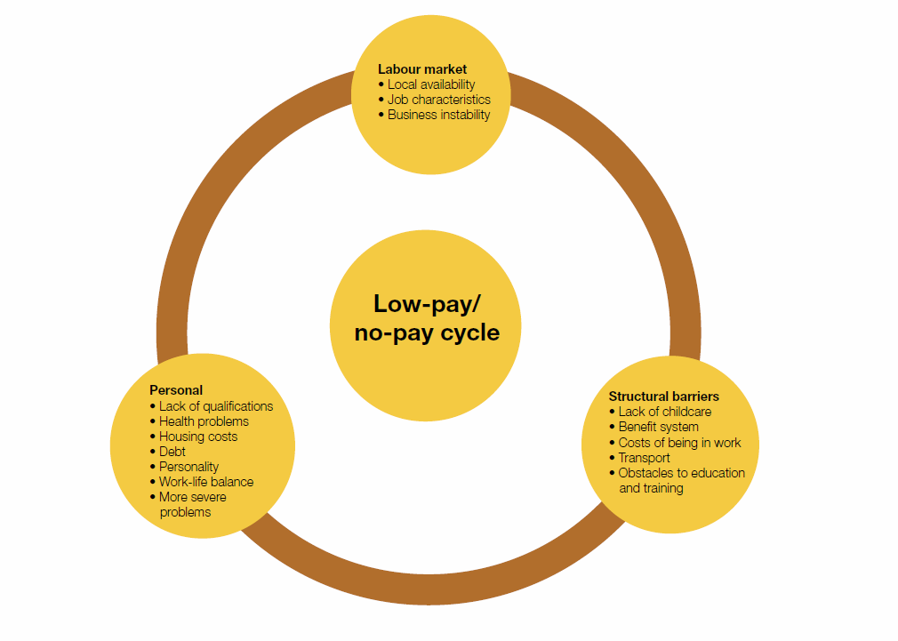
Barriers to escaping the cycle

Slide 8
Limited opportunities in workplace
“[I’ve been] trying to feel out what would be a good career move for us, try and get a permanent job. [I] kind of end up getting temporary work a lot, and end up thinking, it’s work, but obviously would be better permanent ... I never seem to get any further forward on what I want to actually achieve.”

Slide 9
Attitudes towards progression
“I enjoy my job too much. I would rather be comfortable in the job I love than in a higher paid job that I might not enjoy, and I don’t want to get somewhere and think, Oh heck, I wish I’d stayed [where I was] because I might not be able to go back, then I’m stuck, then my stress level gets high.”
Difficulties with training as a route out

Slide 10
A role model
“I think it’s really important that both my children learn what is the right way to do things, that you work. My children think that everybody goes to college when they leave school because they’ve seen me studying on constantly. I want them to have those values that you work for a living and you earn money and you reach your potential, so I think it’s important as a role model to them for them to see that.”
Rachel, lone parent with 2 children, unemployed

Slide 11
Childcare
“Basically it is not being able to say to the employer when I can start, what hours I can do, until you have childcare in place … but you can’t get childcare until you are working, so you just go round in circles.”
Jane, lone parent with 4 children, unemployed

Slide 12
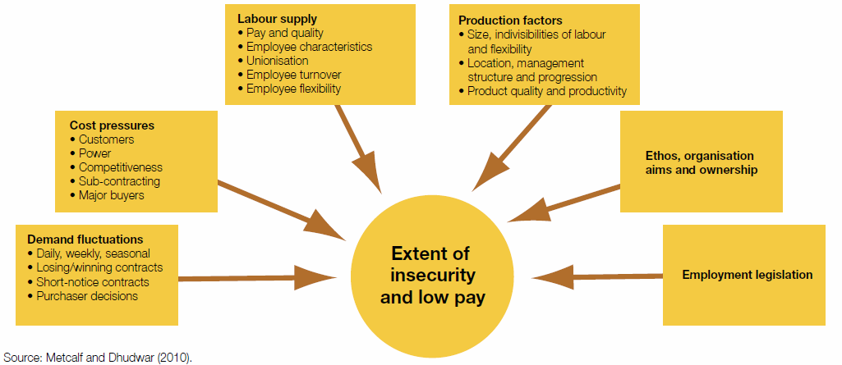
Drivers for employers

Slide 13
Employer’s role in the cycle
Causes of use of temporary labour in search of lower costs:
Competitive pressures; demand fluctuations; low skill requirements and a ready labour supply
Dominant purchaser power may worsen fluctuations and cost pressures on suppliers
Emphasis on cost in public sector purchasing has encouraged temporary/ insecure employment
Conflict between purchasing policy and anti-poverty policy?
But economic pressures do not wholly determine employment organisation - employers’ responses differ
‘Living wage’ policies change production techniques, leading to more secure employment as well as higher wages

Slide 14
Policy, practice and behaviour
Policy & practice must reflect income dynamics
Low-pay/no-pay cycling has risen 60%+ in recession
Employers: could choose different HR models
Agency workers: improve rights & conditions
Directive under review – but implement by end 2011
Pay: raise through ‘living wage’ or NMW
Public sector purchasing: address issues in contracts
Job advice: cover security, pay & progression
Childcare: more flexible, available and affordable
Common interest in a high-skill / wage / GDP economy?

