Slide 1
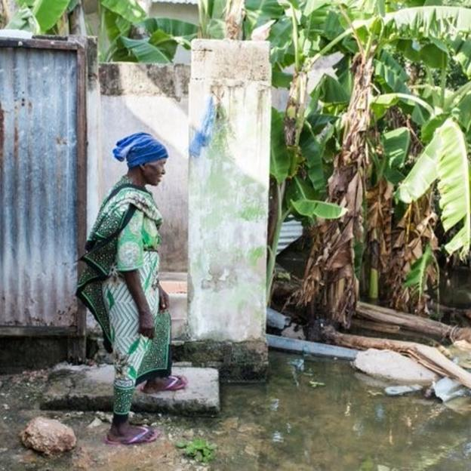
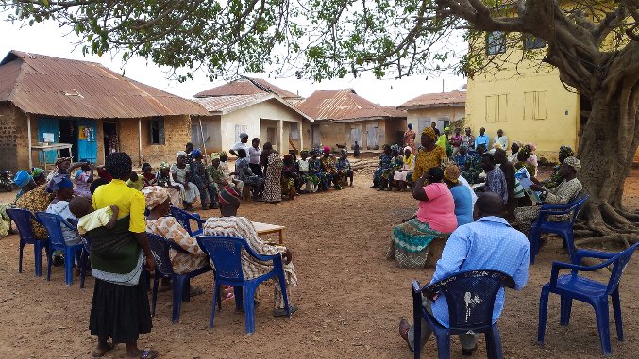
Evidence for Policy Design Community Led Total Sanitation
Nigeria Inclusive Sanitation Webinar Series
Webinar 2: Awareness Creation and Market-based Sanitation
1st December 2020
Laura Abramovsky
Joint work with Britta Augsburg, Melanie Lührmann, F. Oteiza and J.P. Rud

Slide 2
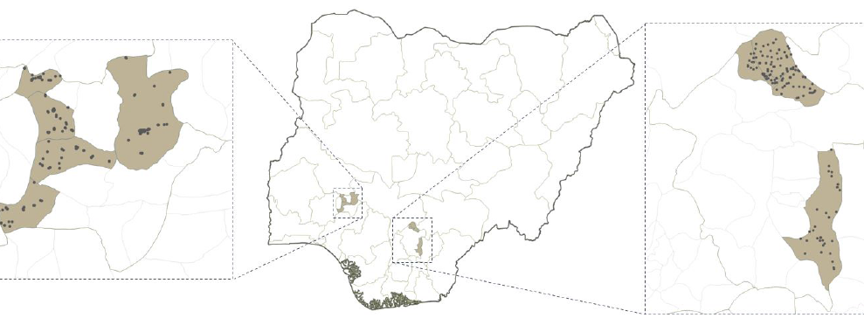
Background
WaterAid Nigeria implemented CLTS in Enugu, Ekiti and Jigawa and SanMark in Ekiti and Enugu
This presentation focuses on the 2014-2018 impact evaluation of CLTS, as implemented in 2015 in rural Ekiti and Enugu
CLTS was implemented at scale in close collaboration with local LGAs, NGOs and communities’ leaders
CLTS was implemented in 80% of targeted communities, mostly using Defecation Mapping activities
Ekiti
CLTS targeted to
66 rural communities
(randomly chosen among a group of 129)
Enugu
CLTS targeted to
63 rural communities (randomly chosen among a group of 118)

Slide 3
CLTS evaluation
Long-term evaluation over the period 2014-2018, data collection timeline :
Cluster Randomized Control Trial:
247 rural community clusters randomly allocated to CLTS and Control
Sampling over 4,600 households
Primary outcomes:
Open Defecation (OD)
Toilet ownership and usage
2014
2015
2016
2017
2018
Baseline
survey
CLTS
FU 1
8 months
FU 2
24 months
FU 3
32 months
time

Slide 4
Key findings
CLTS successfully improved sanitation behavior in poor rural communities
It generated a decrease in OD of 9pp
Though OD is still high after CLTS at 53%
OD decreased through increased ownership of functioning toilets by 10pp, reaching 34%
Impact is sustained in the medium- to long-term (2.5 years after intervention)
CLTS did not work in richer communities
No impact on OD (still at 36%) or functioning toilet ownership (still at 46%), and more difficult to trigger
Notes:
Poor communities: those whose community wealth is below Nigerian median
Wealth measure:
Based on asset ownership information of households (owning a motorcycle, furniture, satellite dish, etc)
Index created at HH level, averaged for community

Slide 5
Main policy takeaways to inform national sanitation strategy in rural communities
CLTS alone won’t eradicate OD in rural Nigeria
Consistent with findings from other countries
Target CLTS to improve its effectiveness
Target CLTS towards poor communities, to ensure more efficient use of funds
Explore improving intensity: follow-up activities have been effective in other contexts
Complement CLTS in poor communities with other interventions
To tackle other households’ constraints, e.g. regarding affordability and liquidity constraints

Slide 6
Strategic targeting of CLTS: poor communities with high OD rates and no previous exposure to CLTS
Darker red: higher proportion of poor rural communities & higher OD proportion
Definition: states in which 1 in 2 rural communities are poor & 1 in 2 rural households engage in OD
This can be replicated using available data from the Demographic and Health Survey 2018
Combined with information from the field on previous CLTS exposure
Data source: DHS 2013

Slide 7
Upcoming workshop on our work in WASH in Nigeria
If you would like to know more about our work on WASH themes in Nigeria, join us on January 25th from 3-5pm GMT+1 (Nigeria time) / 2-4pm GMT (London time)
for
An in-depth discussion of the CLTS evidence, with details on how to develop a targeted approach in your state
New RCT evidence from Nigeria on the effectiveness of Sanitation Marketing
Evidence on WASH standards in formal and informal Nigerian daycare settings
Please sign up for the event here: https://ifs.org.uk/events/1872

Slide 8
THANK YOU!!!!
Contact details:
Laura Abramovsky: laura_a@ifs.org.uk
Britta Augsburg: britta_a@ifs.org.uk
Melanie Luhrmann: melanie_l@ifs.org.uk

