Slide 1
David Phillips
Property taxes: ripe for reform or a poisoned chalice?
Associate Director, Institute for Fiscal Studies
Notes:
Good morning everyone. It’s a pleasure to join you as we kick off this important conference.
The focus of my presentation is Great Britain’s system of property taxes – are they ripe for reform, or a poisoned chalice?
I’ll argue reform is a prize worth fighting for and that while the politics are tough, there are practical steps to address these challenges.
OK, let’s begin.

Slide 2
Property taxes in Great Britain
Council tax:
Business rates:
Property transactions taxes:
Notes:
There are three main property taxes in Great Britain.
[Read]

Slide 3
Property taxes in Great Britain
Council tax:
£41bn in England, £2.9bn in Scotland and £2.1bn in Wales
Banded structure, based on 1991 values in England & Scotland, 2003 values in Wales
Business rates:
£27 bn in England, £3.1bn in Scotland and £1.1bn in Wales (exc. central lists)
Continuous system, based on 2021 rents in England & Wales, 2022 rents in Scotland
Property transactions taxes:
£13 bn in England, £0.8bn in Scotland and £0.3bn in Wales
Sale or long-lease value, with a marginal rate system for main residence, wedge systems for 2nd homes & rental homes and non-residential
These are large taxes – getting their design right is important
Notes:
Council tax is the largest overall, raising £41 billion in England, just under £3 billion in Scotland, and just over £2 billion in Wales.
It has a banded structure, based on 1991 property values in England and Scotland and 2003 values in Wales, following a revaluation that took place there in 2005.
Business rates is the next largest, raising £27 billion in England, £3 billion in Scotland and just over £1 billion in Wales.
It is a continuous system, where rates bills are based on estimated rental values as of April 2021 in England and Wales and 2022 in Scotland, given a cycle of revaluations.
By property tax I mean stamp duty land tax in England and the devolved equivalents in Scotland and Wales. These taxes raise £13 billion in England, £0.8 billion in Scotland and £0.3 billion in Wales.
They are based on the sale or long-lease value of property, with a marginal rate system for main residence, and a wedge system for 2nd homes and rental homes, and non-residential property.
So these are taxes raising large amounts of revenue – over 10% of all tax revenues – which means getting their design and administration right is important.

Slide 4
Key issues with current system
Council tax
Out of date, creating horizontal inequities
Notes:
And at the moment, while these taxes are well administered overall, their design is not fit for purpose.
Turning first to council tax. It is now hideously out of date, being based on 1991 property values. This creates real unfairness and horizontal inequities.

Slide 5
Change in property value by region
Issue is not that average values have increased so much – it is that increases have varied significantly
Source: Adam et al (2020), updated.
Notes:
1991 is so long ago we don’t have estimates of property values by region for all regions back that far – the figures begin in 1995. Since then property values have increased nearly 6 fold across England as a whole.
But this isn’t the real problem – it’s that the values of different properties in different parts of the country have changed in such different ways.

Slide 6
Change in property value by region
Issue is not that average values have increased so much – it is that increases have varied significantly
Properties now worth very different amounts in same band, with same bill
Properties now worth same in different bands, with very different bills
Source: Adam et al (2020), updated.
Notes:
For example, average values have increased less than 4-fold in the North East of England, compared to 7-fold in London. At a very local level the differences are even bigger.
What this means is that if you were to reband properties now based on up-to-date values so that the same share was in each band as now nationally, main properties, probably over half, would end up in different bands.
Under the status quo, properties now worth very different amounts are in the same band with the same bill.
Properties now worth the same can be in different bands with very different bills because of what they used to be worth.
This is unfair.

Slide 7
Key issues with current system
Council tax
Out of date, creating horizontal inequities
Regressive with wrt property value, creating vertical inequities
Notes:
Council tax is also highly regressive with respect to property value – those living in low value properties pay a bill that is a much higher share of their property’s value than those in high value properties.

Slide 8
Effective tax rate by property value (1991)
£50k = 3.4%
£500k = 0.9%
Source: Adam et al (2020).
Notes:
That is because council tax for Band H properties is 3 times as high as for Band I properties, despite Band H properties being worth at least 8 times as much. This chart shows that means a property that was worth £50k as of 1991 pays a tax rate of 3.4% of its then value. But a property worth £500k as of 1991 pays a tax of 0.9% of its then value.
There are a huge range of views on how progressive the tax system should be, but it is unusual to have a tax that is regressive by design. This regressivity is particularly striking given the efficiency of residential property taxes mean using them to redistribute causes less economic damage than most other taxes.

Slide 9
Key issues with current system
Council tax
Out of date, creating horizontal inequities
Regressive with wrt property value, creating vertical inequities
Distorts housing choices
Business rates
Complex set of reliefs that distorts property usage
Notes:
It’s also worth noting that the range of discounts, exemptions and premiums in council tax distorts housing choices. Sometimes deliberately. Sometimes less so. The single person discount, is a bigger cash discount for high-value high-band properties than low-band low-value properties, for example. That means it reduces the cost of living in bigger, more expensive properties for single adults relative to other households. It’s probably not a big effect, but this contributes to both under-occupation and over-crowding of housing.
Turning to business rates, a complex set of reliefs also distorts property usage. Again, sometimes deliberately, but not always with a clear underlying rationale.

Slide 10
Distortions to business property usage
Source: Lockwood et al (2023).
Notes:
Consider the small business rate relief. In England, this means that small businesses get reduced or zero bills if they occupy a property with a rateable value of less than £15k, but larger businesses with more than one property don’t. You can see that here on this chart.

Slide 11
Distortions to business property usage
Source: Lockwood et al (2023).
Notes:
This second panel shows how this affects what type of business occupies different types of property.
You can see that over 70% of properties with a value of £6000 are occupied by small businesses. That slowly falls to about 60% for properties with a value of £12000.
But then at the point small business rate relief gets withdrawn, the share plummets – to 35% for a value of £15,000.
This is strong evidence that the relief is significantly shifting the market in favour of small businesses with one property.
It’s not clear this is good – businesses are not the same as people, and the owner or employees of a small business are not necessarily poorer than the shareholders or employees of a bigger business.

Slide 12
Key issues with current system
Council tax
Out of date, creating horizontal inequities
Regressive with wrt property value, creating vertical inequities
Distorts housing choices
Business rates
Complex set of reliefs that distorts property usage
Discourages use of property by business, distorting production decisions
Notes:
More generally, business rates discourage the use of property by business, distorting production decisions away from property intensive activities and production methods.
It’s a little hard to show this clearly, but vacancy rates can help.

Slide 13
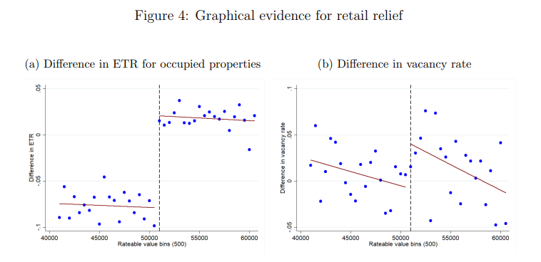
Discourages property usage
Source: Lockwood et al (2023).
Notes:
Consider retail properties.
In the late 2010s there was a discount on bills for retail properties worth £51k or less. You can see that in this chart – bills jumped up above that point.

Slide 14
Discourages property usage
Source: Lockwood et al (2023).
Notes:
This second panel shows vacancy rates. The effect is a bit fuzzy, but there was also a statistically significant jump up in vacancy rates above this point. That shows how, in the short-term, business rates can reduce the demand for property.
In the medium-term, lower demand for property would reduce rents and in the longer-term the supply of property.

Slide 15
Key issues with current system
Council tax
Out of date, creating horizontal inequities
Regressive with wrt property value, creating vertical inequities
Distorts housing choices
Business rates
Complex set of reliefs that distorts property usage
Discourages use of property by business, distorting production decisions
Property transactions taxes
Additional tax on 2nd homes & rental properties distorts housing choices
Discourages mutually beneficial property transactions – gumming up property market
Notes:
Finally, let’s turn to the problems with our property transactions taxes.
Again, these distort housing choices – with 2nd homes and the private rental sector discouraged. The extra stamp duty paid by landlords and second home-owners pay come on top of the capital gains, inheritance tax and income tax penalties they face relative to owner occupiers. By penalizing landlords, its not just them that lose out – potentially low-income tenants with little chance of becoming owners also lose as a lower supply of rental properties pushes up rents.
More generally, property transactions taxes are some of the most damaging taxes we have. By imposing a cost every time a property changes hands, they discourage mutually beneficial property transactions, gumming up the property market and the wider economy.

Slide 16
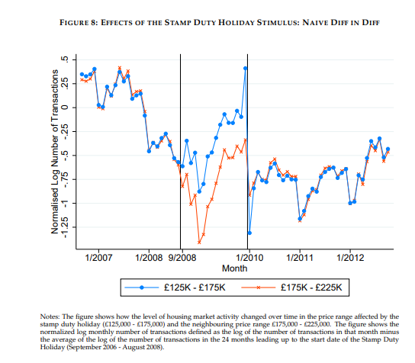
Stamp duty depresses transactions
Stamp duty holiday in late 2000s on properties worth £125 - £175k increased transactions by approximately 20%
Only partially offset by fewer transactions once holiday came to end
Implies BIG reduction in transactions due to stamp duty land tax
Source: Best and Kleven (2018).
Notes:
The effects on transactions can be significant.
This can be seen by looking at what happens during stamp duty holidays, such as the one during the late 2000s financial crisis.
Properties worth between £125k and £175k had a stamp duty holiday. Those worth more than this didn’t.
You can see that while sales tracked closely before the holiday, once it was in place, far more properties worth 125-175k transacted.
Indeed a 1 percentage point cut in stamp duty boosted transactions about 20%. And this was only partially – probably less than half – offset by fewer transactions later.
This implies stamp duty significantly reduces the number of transactions – especially considering high value properties can face much higher tax rates than 1%.

Slide 17
State of play
Council tax
Wales has legislated for 5-yearly revaluations from 2028, with potential wider reforms
Scotland halted planned increases in bills for Band E+, but alternate reforms possible
UK government downplay prospects for reform
Business rates
Welsh Ministers have new powers to vary reliefs and multipliers
Labour proposed to “abolish” business rates and introduce revenue-neutral replacement but have provided no detail
Property transactions taxes
Temporary reduction for first time buyers in England set to expire next March
Notes:
So, we have three taxes that need reform. What is the state of play?
For council tax, the Welsh Government has actually legislated for 5-yearly revaluations from 2028, and has been considering wider reforms too, although this has been pushed back from 2025 and there is clearly a risk of further postponement or cancellation.
Scotland had planned to increase taxes on Band E+ properties from this April, repeating previous increases in 2017. But that was controversially scrapped at last year’s SNP conference.. All parties bar the Conservatives promised at least investigating reform in the last Scottish elections though so my fingers are crossed that we’ll see new plans emerge.
For England, in response to rumours in the press the new UK government has been pouring cold water on the idea of revaluation and reform – which is disappointing.
For business rates, new legislation gives Welsh Ministers additional powers, which could be used wisely or unwisely. In England, Labour have said they will abolish business rates but have given virtually no detail on what this may mean.
Lastly, property transactions taxes are more likely to move in the wrong direction – up – than in the right, it seems.

Slide 18
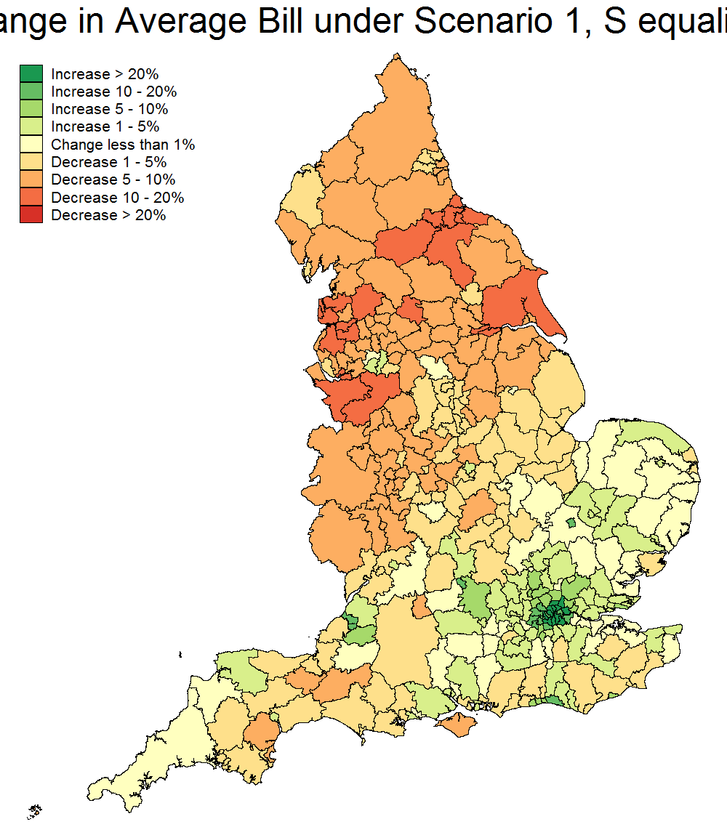
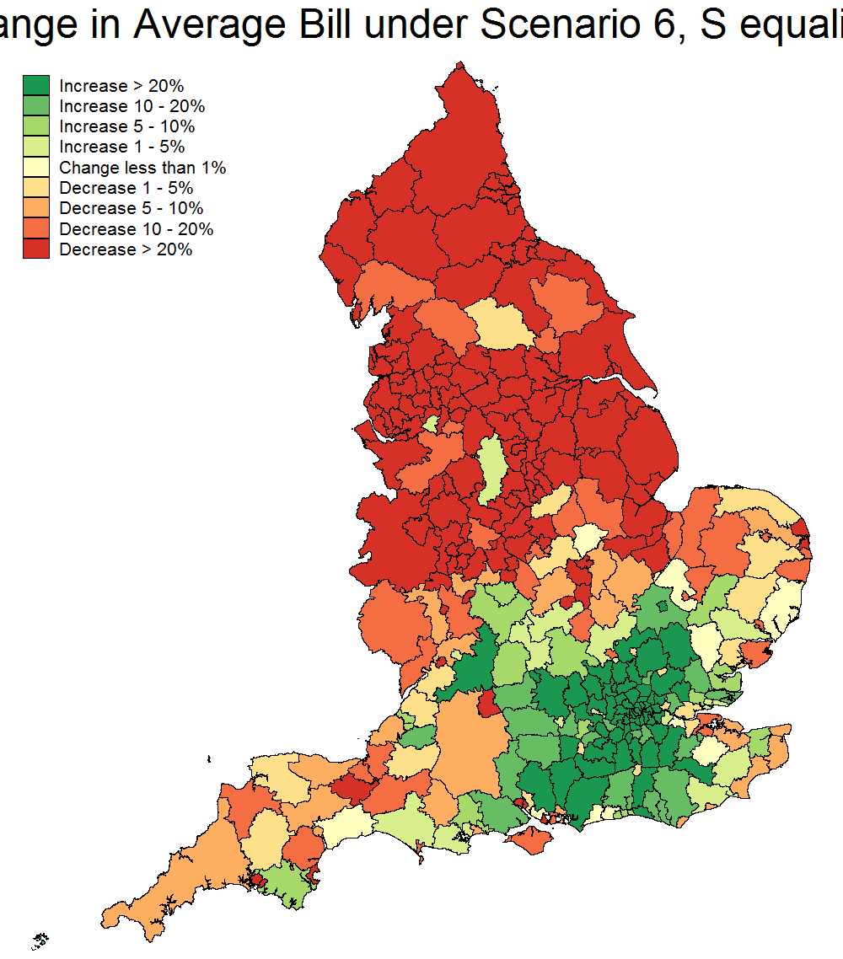
What to do? Revalue and reform council tax
Change in average bill by local authority (Q1 2019)
1. Pure Revaluation
5. Continuous and proportional system
Q1 2019 values
Revenue neutral
Full redist^{bn} of grant & baseline funding
Kingston-upon-Hull: - 60%
Fylde: - 15%
Wyre: - 15%
Blackpool: - 56%
Hackney: + 45% Wandsworth: + 34%
Westminster: + 410%
Kensington & Chelsea: + 358%
Source: Adam et al (2020).
Notes:
So what should be done?
For council tax, revaluation is the bare minimum. Wider reform should also be considered.
Back in 2020 we modelled what a revalued system, and what a revalued system made proportional to property value would do to bills for different households in different parts of the country. We modelled it assuming revenues and hence average bills would be the same across England, and that grant funding for councils would be redistributed to account for changes in their tax bases.
How would impacts vary across England? Well because prices have gone up by less than average in the North and much more in parts of inner London in particular, average bills would fall in the North and go up in London. As of Q1 2019, the biggest falls would be in parts of Lancashire. The biggest rises in Hackney and Wandsworth.
A fully proportional system would have a much bigger impacts. Bills would fall by over half in parts of the North like Blackpool and Hull where values are both low and have increased relatively little. But they’d rise very significantly in the most expensive areas, such as Westminster and Kensington and Chelsea, where currently multi-million pound properties can face bills in line with semi-detached properties worth a fraction of their value.

Slide 19
What to do? Revalue and reform council tax
Change in bill as % of income, proportional system
London
East, South East, South West
Midlands and North
Source: Adam et al (2020).
Notes:
This chart shows changes in bills measured as a share of household income across the income distribution from poorest on the left to richest on the right.
You can see in the North, households right across the distribution would see their bills fall, on average, especially among low-to-middle income households.
In the South outside London, low and middle income households would gain on average, while richer ones would pay more.
In London, high property values mean even low income households would lose, on average. As we discuss there are ways to help address this issue though.

Slide 20
What to do? Revalue and reform council tax
Reform of discounts and exemptions
Design of single person discount contributes to both under-occupation and overcrowding
Put in place a cycle of regular revaluations
Do not let things get so out of date again
Clarity for taxpayers
Use modern valuation techniques
Computerised statistical valuation reduces cost of valuations
Avoid valuer-specific effects (fairer?), although manual checks will be needed
Notes:
Beyond revaluation and reforming the tax rate structure, there are a number of other changes that should be made:
Reforming discounts and exemptions, and especially the single person discount
Putting in place a cycle of regular revaluations – it’s not a one of reform.
And using modern valuation techniques, using computerised and statistical techniques – of course with the backstop of manual valuations to ensure quality.

Slide 21
What to do? Make business rates less damaging
Simplify and give clarity on business rates reliefs
Future of supposedly temporary reliefs (e.g. for retail, hospitality and leisure sectors)
Temporary, targeted reliefs likely to benefit occupiers more than long-term, broad reliefs – but add to complexity
Ultimate goal: move to a land-value tax
Avoids discouraging property use, as tax only depends on underlying land value not the property built on it
Stepping stone: remove things most likely to be distorted from the taxbase, e.g. integral plant and machinery.
Avoid the siren calls
Business rates not main reason for decline of high street – need a clear rationale as to why high street retail is preferred to online, if want to support it
Notes:
On business rates, at the very least, reliefs should be simplified where possible, and clarity given on whether supposedly temporary reliefs that keep getting extended are actually permanent.
Ultimately, we should move towards a land value tax – removing property from the tax base. That avoids distorting property usage. And as a stepping stone, one could remove things where behaviour is most likely to be distorted from the taxbase – such as integral plant and machinery.
It’s also important to avoid the siren calls. Business rates are not the main reason for the decline of the high street – changing technology is. Cutting rates for the high street and increasing it for e-commerce warehouses, for example, is tilting not levelling the playing field. A clear rationale for why we, as a society, value the high street above and beyond shoppers’ revealed preference by where they choose to shop, is needed if we are to continue supporting it via the tax system.

Slide 22
What to do? Abolish or reduce SDLT as part of a grand bargain
Property transactions taxes are some of the most damaging we have
By gumming up property market, gum up labour market, reduce downsizing/upsizing, etc.
Abolish or reduce transactions taxes
Make up revenue from revalued, reformed recurrent property taxes
More efficient: raise the same and redistribute the same for less economic damage
Fairer: aligns taxes with up-to-date values, and avoids penalising those whose circumstances mean moving more often
Growth enhancing reform possibly by all GB governments
Council tax, business rates and transactions all devolved to Scottish & Welsh Govts
Notes:
On property transactions taxes, the answer is simple – we should seek to reduce or ideally abolish them, and make up the revenue elsewhere, including perhaps revalued and reformed recurrent property taxes.
That’d be more efficient – you could raise the same and redistribute the same for less economic damage as you’d no longer be gumming up the property and labour markets.
And it’d be fairer – by aligning taxes with up-to-date values, and avoiding penalising households and businesses whose circumstance change and mean they need to move more often.
And this growth enhancing reform is possible by all governments in Britain – including the Scottish and Welsh Governments. Given a focus on fairness and growth across the country currently, tax reforms like this need to be on the table.

Slide 23
Easing the pain of reform
Need a strong narrative / rationale for reform
Fairness/progressivity, boost to property supply and growth?
Easier to do for a bolder package of reform than a simple revaluation?
Tailor to political context
Revenue neutral, or revenue-raising?
Transitional protection and mitigating measures
Phase in big changes in bills – but don’t delay them to after property sale
Deferral scheme for asset rich / cash poor?
Enhanced CTRS for asset poor / cash poor?
Less-than-full equalisation across local authority areas
Role for local government
Major reform centrally, but greater powers post-reform?
Notes:
Of course I’m not naïve – reform is politically and practically challenging. But I think there are a few ways to ease the pain.
First is to have a strong narrative and rationale for reform. Doing it for fairness. Doing it for growth. Apologetic “we have to” arguments are unlikely to wash as we’ve seen with the Winter Fuel Payment debate. I think a bolder package of reform makes it easier to build that strong narrative.
Second is to tailor to political context. In Wales, where a previous revaluation saw more properties move up than down bands, and was hence seen as a tax grab, a commitment to revenue neutrality is seen as an important part of the narrative of “fairness”. In Scotland though, the government has made a big play of those with broader shoulders paying more to support public services and benefits, so revenue-raising reforms may make more sense.
Third is to include meaningful transitional protection and mitigation measures. These can go beyond just phasing changes in, with several countries allowing the asset rich but cash poor to defer part of their bills to sale or death.
And I think reforms to local tax can be packaged up with reforms to local government funding and devolution too. A true grand bargain linked to fairness, growth and local empowerment.

Slide 24
Time to leave Chesney Hawkes behind
Notes:
Because it’s time to leave Chesney Hawkes behind.
His hit “the one and only” was number 1 when English and Scottish homes were valued the one and only time for council tax purposes.
Even this classic has been updated in the years since.
It’s time to do the same with council tax and our wider property tax system.

Slide 25
David Phillips
Property taxes: ripe for reform or a poisoned chalice?
Associate Director, Institute for Fiscal Studies

